Slide 1
Implementation of genomic testing in health care – challenges and opportunities
Dag Undlien
Department of Medical Genetics
Oslo University Hospital and University of Oslo
d.e.undlien@medisin.uio.no

Slide 2

Translation from research to clinic is a challenge frequently underestimated
”The process for establishing appropriate policies for implementation of new scientific findings can be frustratingly slow. The median time lag between the earliest publication of a medical discovery and its implementation was 24 years”
Francis Collins, NIH director
We need to do better!

Slide 3
Outline
Current status of genomic diagnostics in our dep
Transition from exome to whole genome sequencing
Data sharing as quality assurance
Interdisciplinarity and Nordic collaboration
From «here and now analysis» to continuous monitoring of genomic data

Slide 4
NGS diagnostics at Dep of Medical Genetics, OUS - germline
Diagnostic exomes
Diagnostic targeted gene panels
Inherited cancers: 70-100/wk
  17 genes panel
Inherited cardiovascular disease
  170 genes panel
Tumor sequencing
Ovarian cancer
  17 gene panel
20 000 genes are sequenced, only genes considered relevant for the particular disease are evaluated (in silico gene panels)

Slide 5
Diagnostic service - germline
Exome sequencing Number of genes
Connective tissue disorders 44 | Hearing disabilities 125
Ciliopathies 158 | Metabolic diseases ≈ 850
Glycosylation disorders 103 | Movement disorders 240
Ictyose 40 | Intellectual disabilities disorders (IDD) 850
Mitocondrial diseases 213 (nuclear DNA) | Trio_IDD 1500
Epidermolysis bullosa 20 | Trio_IDD_exome
Ectodermal dysplasia 34 | Targeted sequencing Number of genes
Immunodeficiensies 308
Migration disorders and pontoc. hypoplasia 136 | Cardiomyopathies 174
Craniofacial malformations 109 | Inherited cancer 17
Inherited liverdiseases 198
Ocular diseases ≈ 400 | Reanalyses of additional gene panels

Slide 6
Somatic and germline in one test – ovarian cancer
Seq of blood if
BRCA positive
Collection of blood and biopsy at time of diagnosis
Sequencing of tumor
BRCA negativ
Approx 25 % will have BRCA+ tumor
15 % germline
10 % somatic
Collaboration between pathology
and medical genetics dep

Slide 7
Plan to transition all exome sequencing to WGS in the next couple of years
Accumulating evidence that WGS can replace aCGH/cytogenetics in many cases
making a health economic argument for transitioning
First WGS test to be established will be for critically ill newborns

Slide 8
Data sharing

Slide 9
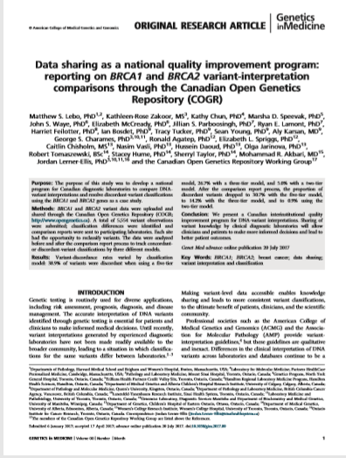
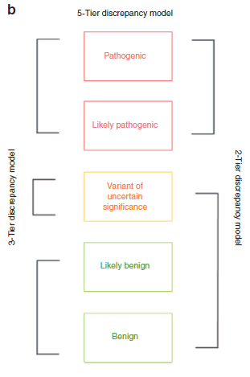
Patient Safety and Variant Sharing

Slide 10
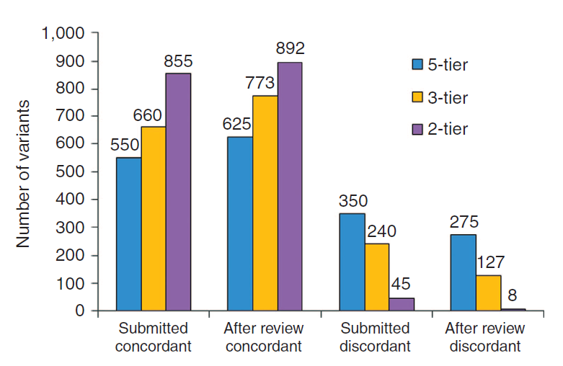
Sharing in Canada leads to quality improvement
Notes:
Need to map variants to both GRCh37 and specific transcripts
4, 5000 CNVs!
Benchmarking was anonymous
11 labs, 5554 BRCA variants (110 – 1072 per lab)
3014 independent variants
1866 by one only
900 two or more
248

Slide 11
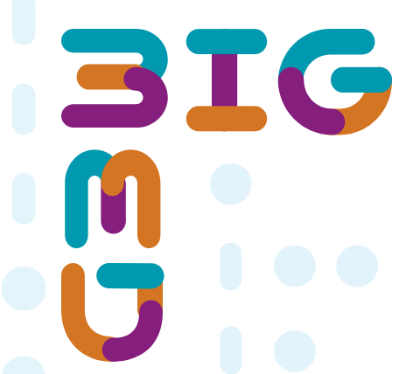
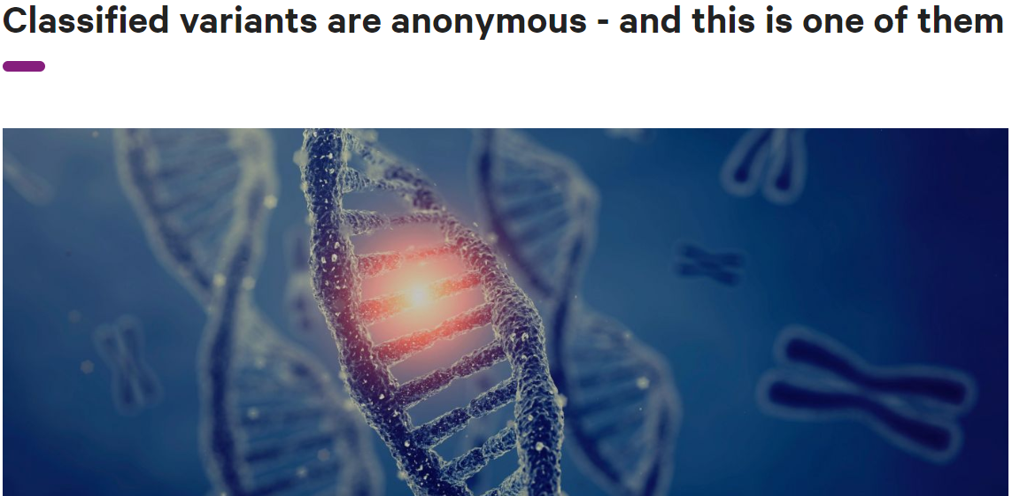
Precision medicine requires interdisciplinarity – legal clarification
Variant: NM_003688.3:c.2603A>G
ACMG-klassifisering: 3* - variant av usikker betydning
*i henhold til kriterier PP3+PM2 som definert i Richards S et al. 2015 Genet Med 17:405

Slide 12
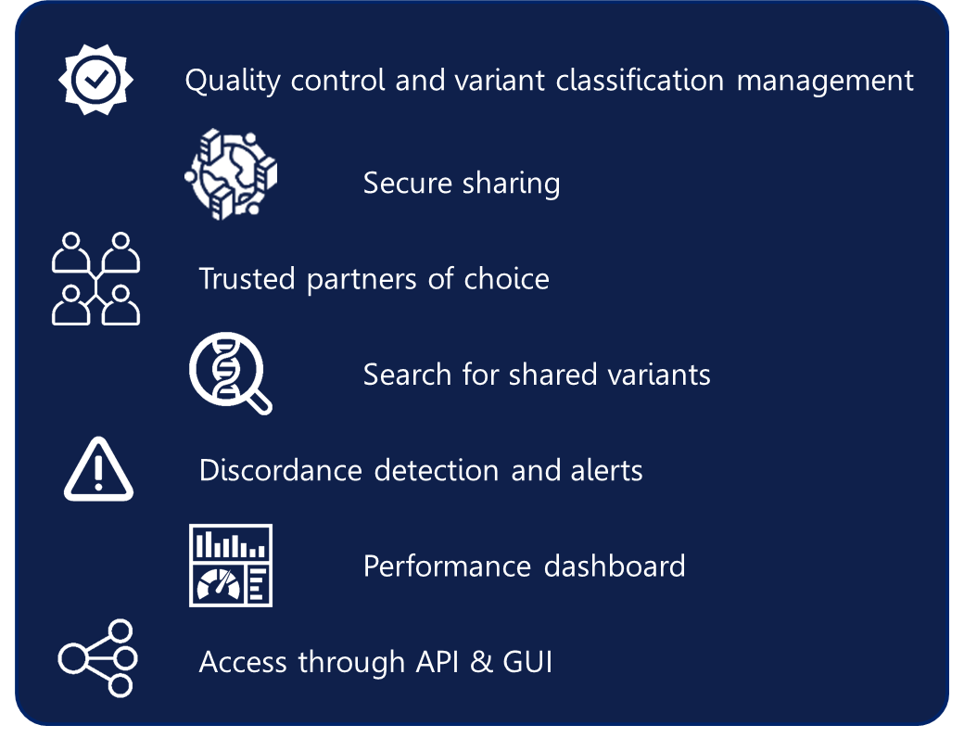
Precision medicine requires international collaboration
DNVGL has developed Variant Exchange as part of the Bigmed project.
Beta testing is ongoing and sharing of variant interpretations between Danish, Icelandic, Swedish(?) labs and OUS is planned
Develop processes for resolving discordances

Slide 13
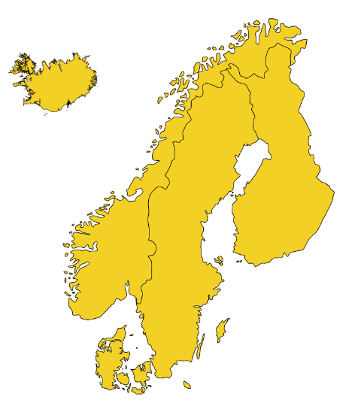
The Nordic value proposition
”Together we are stronger”
  Tradition of collaboration and mobility within the region
  The Nordic co-operation is the world’s oldest regional partnership
Healthcare commonalities
  The Nordic model – well developed welfare states
  ID numbers
  National healthcare systems
  Good biobank and healthcare registries
Shared challenges
  Emerging precision medicine initiatives
  Emerging legal basis for clinical genomics and data sharing
Benefits of collaboration
  When size matters – 25 mill people combined
  Sharing of data, experiences, tools and best practices
Notes:
–”together we are stronger” = Citing the Nordic Council of Ministers

Slide 14

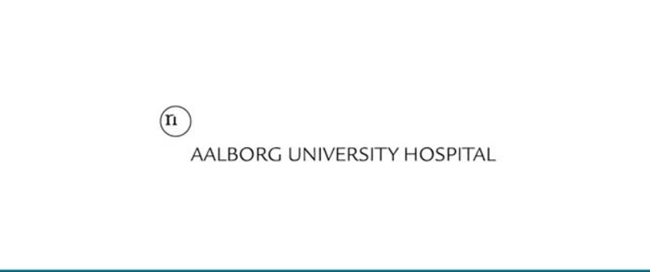











NACG community
Members
Founding partners
Host institutions
Recently expanded with Nordic legal network
Increasing interest from industry
Notes:
NOTE:
- Aarhus not approved yet – TO DO at SC meeting Wednesday
Rigshospitalet:
Center for Genomic Medicine
Department of Clinical Genetics
OUS – AMG
Aalborg: Department of Molecular Diagnostics
St Olavs: Section for genetic laboratory services
One – 1- individual member – Aarhus Univ Hospital

Slide 15
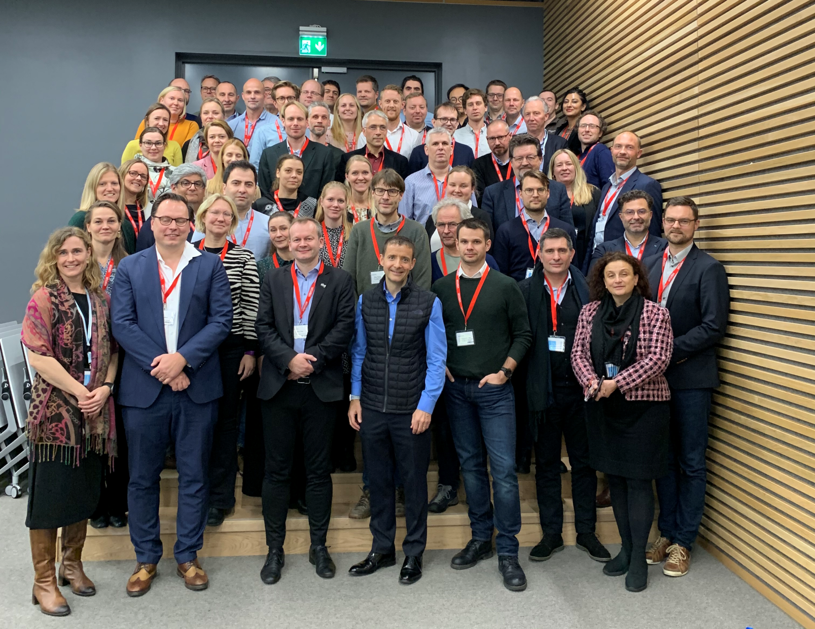
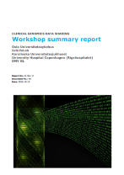
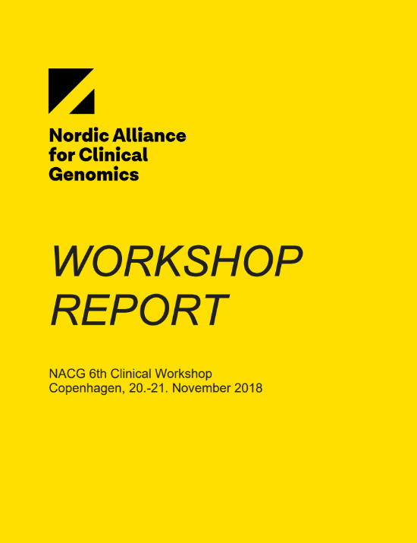
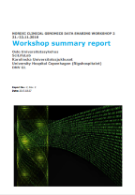
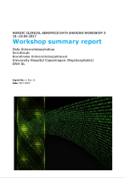
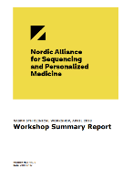
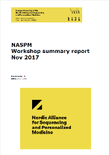
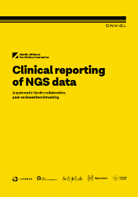
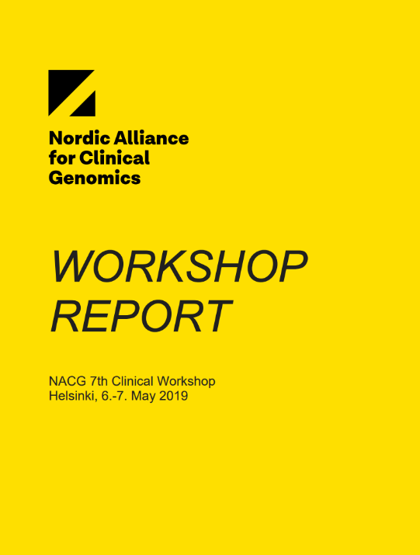
NACG development
2016
2017
2018
WS 6 Copenhagen
WS 2 Stockholm
WS 1 Høvik
WS 3 Copenhagen
Inaugural symposium & WS 4 Høvik
WS 5 Stockholm
2019
WS 7 Helsinki
Symposium & WS 8 Høvik
Notes:
Who is working together on this
Timeline - workshop history
Documentation of workshops and progress
This year: first joint “yellow paper” (paper copy at hand!) – to be presented after lunch

Slide 16
Future ambition
From «here and now analysis» to continuous monitoring

Slide 17
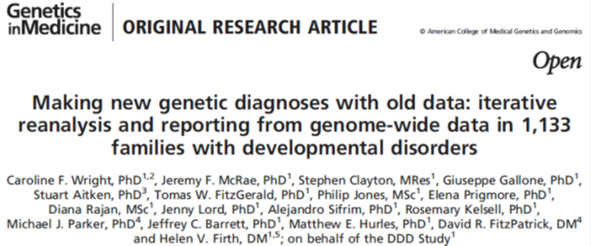
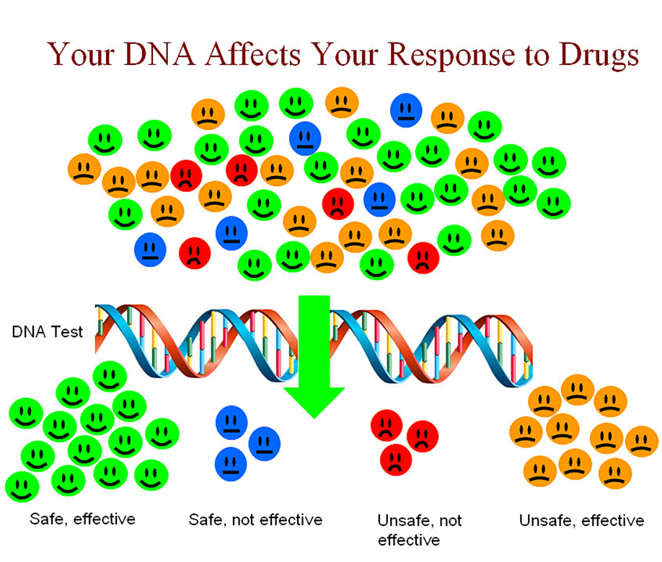
Arguments for reanalyzing genomes
1133 developmental delay disorder patients. Exome sequenced in 2014. Diagnostic yield 27 % (272 patients)
Exomes reanalysed in 2017. Diagnostic yield increased to 40 % (454 patients, 182 with new diagnosis)
Pharmacogentics is currently underutilized

Slide 18
Looking forward – from «here and now analysis» towards continuous monitoring

Slide 19
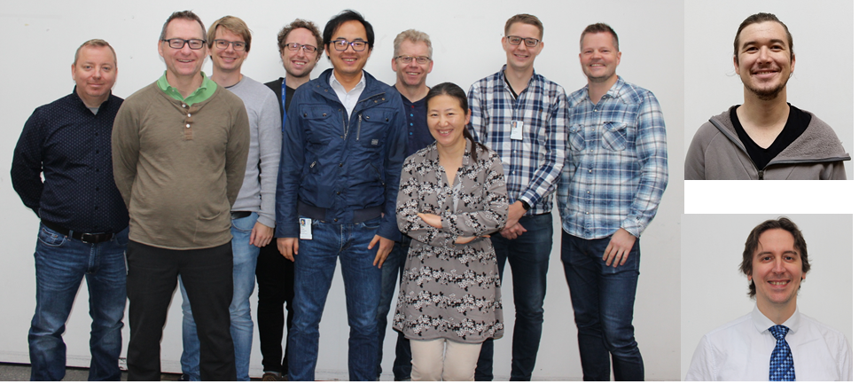
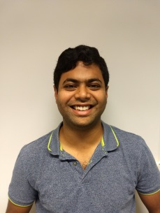
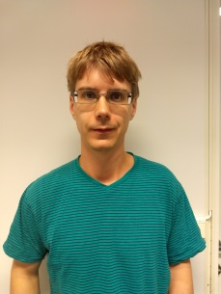
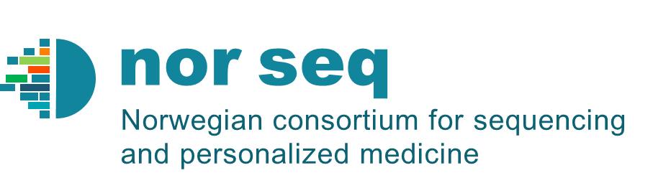


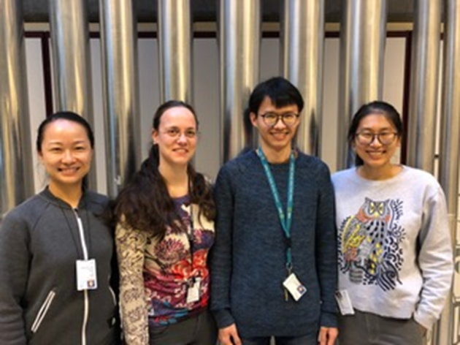
ICT-employees, 2019: bioinformaticians and programmers
Diagnostics and development
Core facility
Recruiting from industry
Simon Rayner’s research group in
bioinformatics
10 years ago Dep of Medical Genetics had noone
with an informatics background

Slide 20
Thanks for your attention

