Slide 1
Activities in OSLO: HORISON 2020
Ole Andreassen, Vessela Kristensen
Institute for Clinical Medicine, Faculty of Medicine, UiO
Cardiovascular disease, mental disporder, cancer

Slide 2
DG RTD Unit (E2-Comabating Diseases) SC1-BHC-01-2019:
Predicting comorbid cardiovascular disease in individuals with mental disorder by decoding disease mechanisms
Ole A. Andreassen
CoE NORMENT
Division of Mental Health and Addiction, Oslo University Hospital Institute of Clinical Medicine, University of Oslo

Slide 3
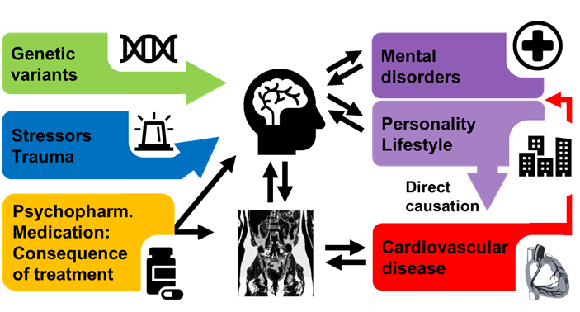
CoMorMent: Predicting comorbid cardiovascular disease in individuals with mental disorder by decoding disease mechanisms

Slide 4
Objectives
To identify genetic variants associated with different trajectories of the co-morbidity of CVD and mental disorders comorbidity. (Discovery).
To identify genetic variants associated with lifestyle and behavioural factors and determine their correlation with CVD and mental disorders comorbidity, and role of non-inherited factors (Nature and Nurture).
To identify the causative mechanisms of the gene variants and develop prediction tools for targeted prevention in a personalized medicine framework (Validation and Biomarkers).

Slide 5
Partners
 | Participant organisation | Country
1 (Co) | University of Oslo | Norway
2 | Karolinska Institute | Sweden
3 | Region Hovedstaden | Denmark
4 | deCODE Genetics | Iceland
5 | University of Tartu | Estonia
6 | University of Edinburgh | UK
7 | AMRA Medical AB | Sweden
8 | HealthLytix | USA

Slide 6
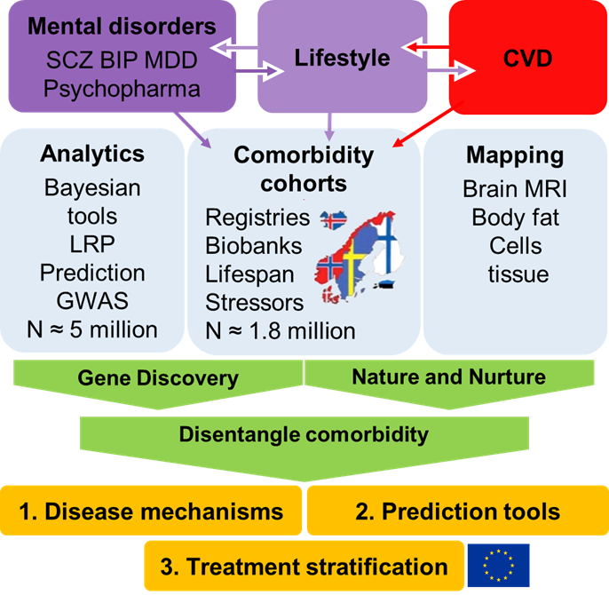
Methodology
Existing comorbidity cohorts
both genotypic and registry-based data – lifespan comorbidities (1.8 mill)
2. Novel analytical big data tools,
gene discoveries, prediction, nature vs. Nurture
3. Functional mapping
MRI brain – body MRI, functional read out, repositories

Slide 7
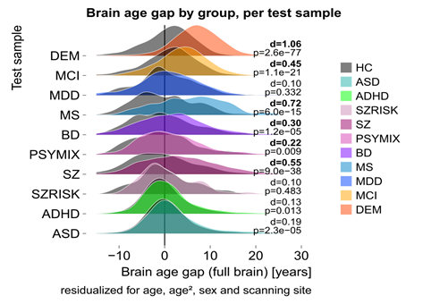
Innovation and impact
Impact
  Enable prevention-through prediction and stratification
  Tools for early diagnosis at preclinical stage, biomarkers
  Improved management and therapy development
  Better prognosis – treatment and outcome
Innovation
  Novel biomarkers (gene variants)
  Algorithms for early detection and monitoring.
  Tools for body MRI
  Combined imaging - genetics tools

Slide 8
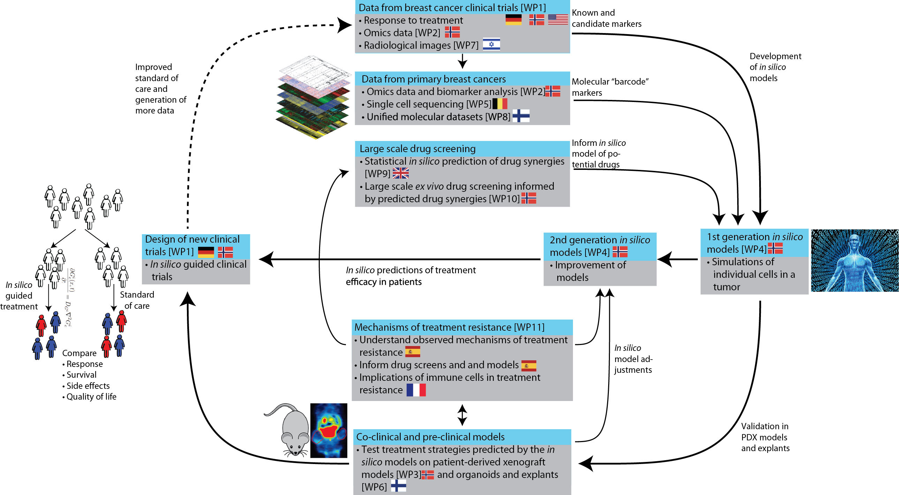
Horizon 2020, H2020-SC1-2019-Two-Stage-RTD, Combinatorial treatment
RESISTANCE UNDER COMBINATORIAL TREATMENT IN ER+ AND ER- BREAST CANCER
Coordinator: Vessela N. Kristensen

Slide 9
Objectives

Slide 10
Participating clinical trials with available clinical and molecular data.
We take an advantage of our longitudinal data from several clinical trials, where multilevel molecular omics data are already generated.
This allows us to compare molecular data from different levels before and after therapy in two arms, with or without additional combinatorial treatment.
Name | N | Patient group | Treatments | Available omics | PI
NeoAva | 138 | Her2 negative, locally advanced | Neo-adjuvant; FEC followed by taxanes +/- bevacizumab | CNA, methylation, mRNA, miRNA, protein (RPPA), metabolic | Olav Engebraaten, NO
NeoAva | 12 | Her2 negative, locally advanced | Neo-adjuvant; hormone treatment +/- bevacizumab | CNA, methylation, mRNA, miRNA, protein (RPPA), metabolic | Olav Engebraaten, NO
GeparQuinto | 2,600 | Triple negative | Neo-adjuvant; chemotherapy +/- bevacizumab | Whole Genome SNP Genotyping (germline) | Peter Fasching, DE
PROMIX | 150 | HER2 negative | Neo-adjuvant; chemotherapy +/- bevacizumab | mRNA | Ingrid Hedenfalk, SE
NEOLETEXE | 24 | Post-menopausal, ER positive, locally advanced | Neo-adjuvnat; letrozole followed by exemestane or exemestane followed by letrozole | WGS (germline and tumor), RNA-seq, protein | Jürgen Geisler, NO
CORRALLEN | 100 | Post-menopausal, ER positive / HER2 negative Luminal B | Ribociclib and letrozole | WGS and RNA-seq | Aleix Prat, ES
CDK | 100 | ER positive, metastatic | CDK4/6 inhibitors and endocrine therapy | WGS and RNA-seq | Aleix Prat, ES
COMPRENDO | 90 | Homologous repair deficient | PARP inhibitor (Olaparib) + PD-1 inhibitor (pembrolizomab) | WGS (germline and tumor), RNA-seq, protein | Peter A. Fasching, DE
CarboDox | 60 | Triple negative | Neo-adjuvant; carboplatin and doxil | WGS, RNA-seq, protein (targeted MS) | Shridar Ganesan, US
Neo-Immunoboost | 50 | Triple negative | Chemotherapy +/- PD-1 inhibitor (pembrolizumab) | WGS (germline and tumor), RNA-seq, protein | Peter A. Fasching, DE
ImmunoLum |  | ER positive/ HER2 negative | Fulvestrant + PD-1 inhibitor (pembrolizomab) | Ongoing | Shridar Ganesan, US
ALICE | 75 | Triple negative | Immunogenic chemotherapy +/- PD-L1 inhibitor (atezolizumab) | Ongoing | Jon-Amund Kyte, NO
ICON | 75 | Luminal B | Immunogenic chemotherapy +/- immunotherapy (ipilimumab + nivolumab) | Ongoing | Jon-Amund Kyte, NO

Slide 12
Partners

Slide 14
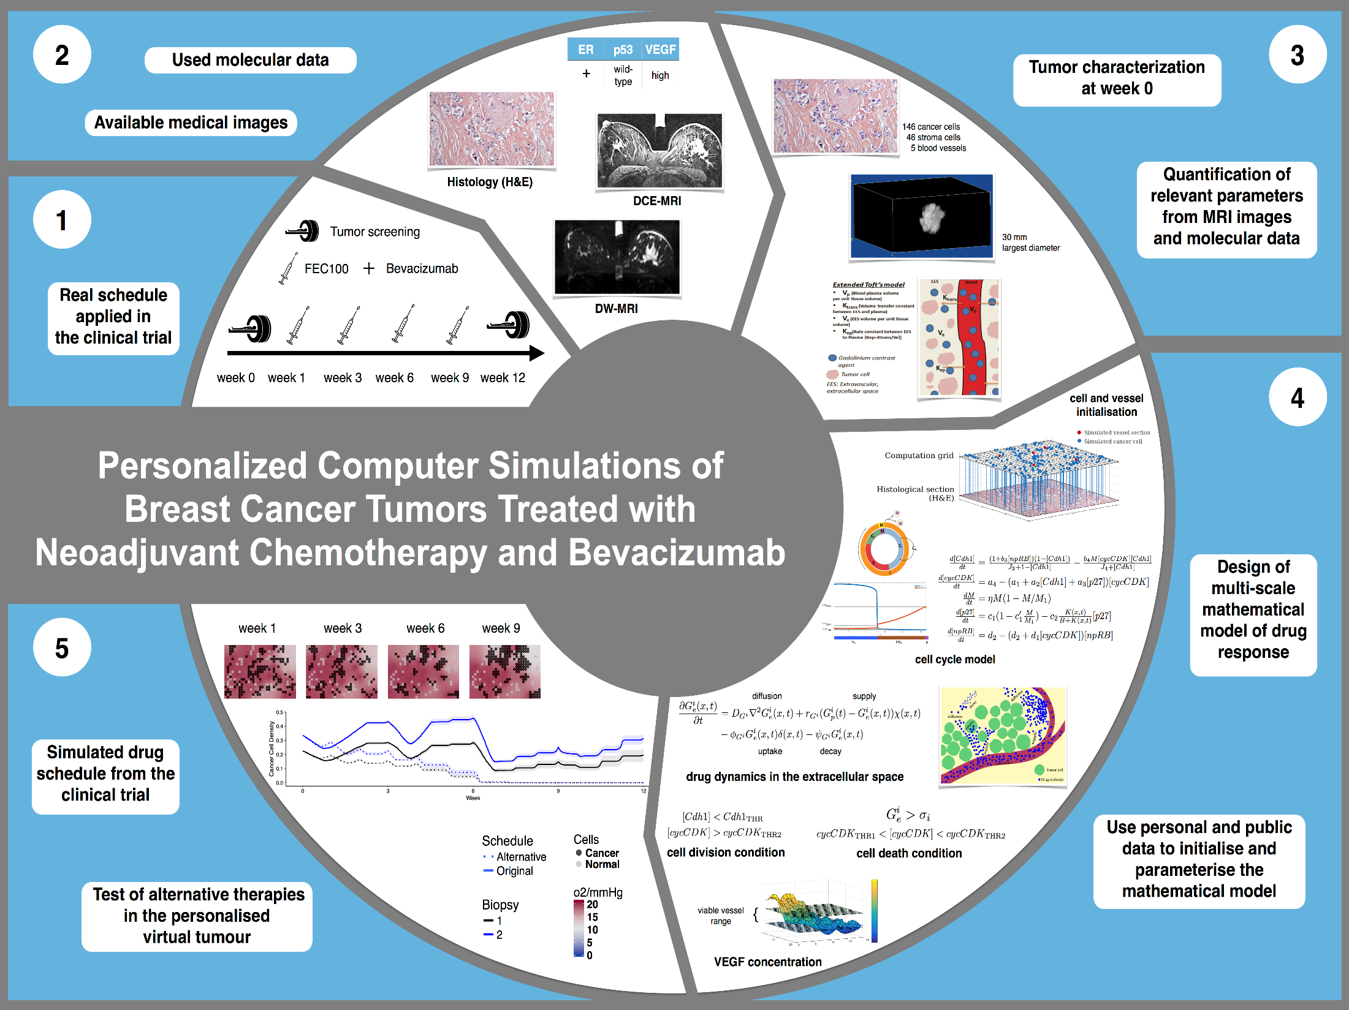
Methodology

Slide 15

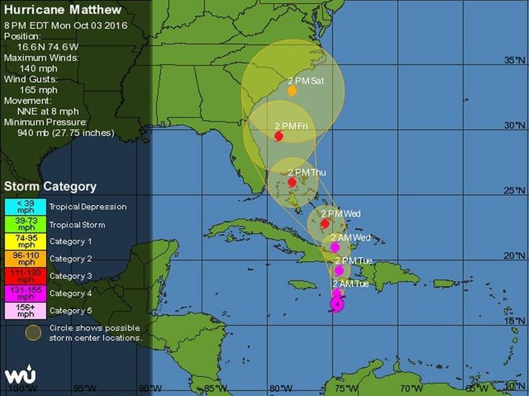
Workshop: Towards in Silico-Guided Clinical Trials in Cancer
May 15th-16th, 2019, at Scandic Holmenkollen Hotel in Oslo, we organise a two-day workshop "Towards in Silico-Guided Clinical Trials in Cancer".
Time and place: May 15, 2019 - May 16, 2019, Scandic Holmenkollen Hotel
Novel concepts for personalised cancer medicine
We bring to Oslo experts in fields such as systems medicine, mathematical oncology and bioinformatics to discuss novel clinical trial concepts for personalised cancer medicine.
Please see the workshop website for more information and registration.
National hurricane center: best hurricane tracking models

Slide 16






Innovation and impact
Åslaug Helland
Fredrik Schjesvold
Geir E. Tjønnfjord
Hege Russnes
Jurgen Geisler
Odd T. Brustugun
Olav Engebråten
Eivind Hovig
Thomas Fleischer
Vessela Kristensen
Torben Luders
Alvaro Köhn-Luque
Andrea Cremaschi
Arnoldo Frigessi
Aslak Tveito
Hesso Farhan
Jukka Corander
Manuela Zucknick
Marie E.Rognes
Riccardo De Bin
Richard Xiaoran Lai
Valeriya Naumova
Camila V Esguerra
Gunhild Mælandsmo
Judith Staerk
Olav Engebråten
Andrea Cremaschi
Arnoldo Frigessi
Eivind Hovig
Kjetil Tasken
Manuela Zucknick
Theresa Ahrens
Imaging
Eirik Malinen
Therese Seierstad
Anna Smajdor
Anne Kjersti Befring
Sigrid S. Skånland
Govinda Raj
Oliver Geier
Dong Wang
Convergence miljeu PERCATHE, UiO Life Science

Slide 17


Oslo, January 27-28, 2020
Holmenkollen Scandic Hotel
The Genetics and Genomics of Cancer
Genome-wide association studies of breast cancer risk
Target gene prediction, drug repositioning and CRISPR screens
Gene-gene and gene-environment interactions in breast cancer susceptibility
Risk factors and survival and risk of contralateral breast cancer
Single cell transcriptomics
Cell type specific epigenetics
High resolution Proteomics
Therapeutic targets from organoid explant cultures
Genomic based therapeutic strategies

