Slide 1
Potensial for innovasjon – persontilpasset medisin
biomedical intelligence report
Bjarte Reve, CEO Nansen Neuroscience Network og rådgiver til PubGene
Mandag, 25.11.19, Sigurd Thoresen workshop 2019

Slide 2
Kort om Bjarte Reve – nåværende engasjement
- Daglig leder i Nansen Neuroscience Network
- Partner i Considium Consulting Group – herav rådgiver for PubGene
- Koordinerer School of Health Innovation for UIO, NTNU og Karolinska Institutet
- Koordinerer Helsementor ordning for Innovasjon Norge på vegne av helseklyngene i Norge
- Folkevalgt i nye Asker kommunestyre for Høyre

Slide 3
" I left the consultation room. The only word I can remember is Cancer. Now what? "

Slide 4
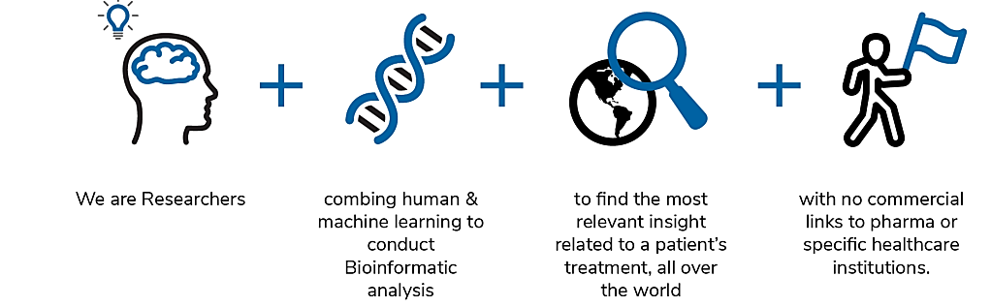
What we do at PubGene
With our technology we aim to bridge the information gap and through this empower patients having a life changing disease to live longer and better their lives by discovering the most precise, effective and evidence-based treatment options.
Human experience and intelligence
combined with machine learning and bioinformatics analysis
finding the most relevant insights related to a patient’s treatment (globally)
with no commercial links to pharma or specific healthcare institutions.
4
Notes:
With our technology we aim to bridge the information gap and through this empower patients having a life changing disease to live longer and better their lives
by discovering the most precise, effective and evidence-based treatment options.
There has been many attempts to fully automate the process of identifying personalized treatment options, but so fare they are not fully up for the challenge.
We believe that the best solution will be to combine human experience and intelligence with machine learning and bioinformatics analysis in order to find the most relevant insight related to a patient's treatment.
It is also important to interact with the treating clinician.
We believe that one can impact patient empowerment, QoL

Slide 5
Our understanding of root causes of disease increases over time
CASE EXAMPLE: Lung Cancer – going from three (3) known underlying causes to discovering >20 between 2004 - 2017
2017
5
Source: Pao & Girard. Lancet Oncol. 2011 Feb;12(2):175-80. Jordan EJ et al. Cancer Discov. 2017 Jun;7(6):596-609
Notes:
I think this presentation is a good way to illustrate this. If we look at Lung Cancer, back in 2004 we talked about three underlying causes and in 2017 this has risen to over 20.
And it is difficult keep up with this pace. Just looking at the Norwegian healthcare system – up until very recently newly diagnosed NSCLC patients were routinely only tested for ALK, EGFR and PDL1. Testing for ROS1 translocation was just recently included here, while there are additional biomarkers that could have an impact on treatment options e. g. BRAF (FDA approved drug available, marketing permit in Norway but not approved by Besluttningsforum). Furthermore, combination of Pembrolizumamb and chemotherapy was only recently approved as first line treatment in Norway even though it was approved by the FDA already in 2018.

Slide 6
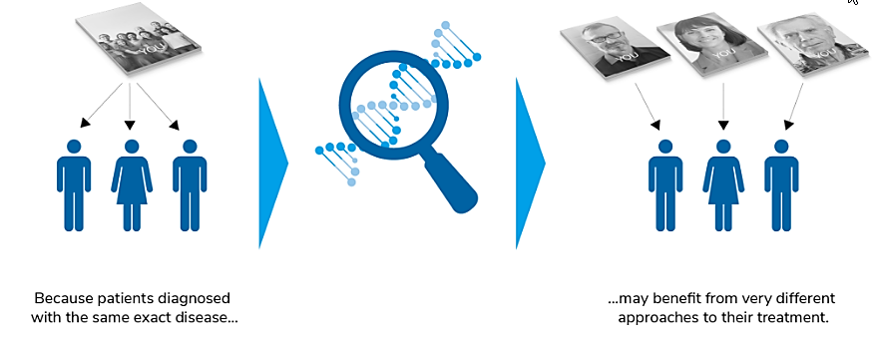
PERSONALISED MEDICINE
Because your health is unique.
Personalised biomedical intelligence needs to be based on individual medical data, including genetic screening and other available biomarker screening methods.
Biomedical intelligence reports should provide patients & clinicians with actionable insight
Aim to determine the best treatment options based on comprehensive bioinformatic analysis
Support and provide better understanding of the healthcare journey and through this increase PE and CoL
6
Notes:
Due to the rapidly evolving field of precision medicine it is a clear need for solutions that can provide tailored biomedical information considering individual medical data including results from genetic screening and other available biomarker screening methods.
Such information needs to provide patients and clinicians with actionable insight
The aim should be to determine the best possible treatment options regardless of location.
This will support and provide the patient with a better understanding of their options during their healthcare journey and through this increase patient empowerment and Quality of life.
The patients need for information when facing a life changing/life threatening disease.
During their search for relevant information both the patients and the healthcare provider meets several key challenges.

Slide 7
Coremine Vitae Empowers Clinicians with…
PERSONALISED DIAGNOSTIC
LATEST INFORMATION
POSSIBLE TREATMENTS
HEALTH ECONOMIC ANALYSIS
…looking at the patient's fully integrated medical "story“.
Coremine Vitae integrates all information about a patient into one comprehensive intelligence report
…on a condition - it is impossible for any one Clinician to keep up with all of the globally available literature and treatments that exist.
Coremine Vitae factors in all globally available information for the Clinician
…or monitoring - or possible life-style related possibilities.
Coremine Vitae does all of that for the Clinician
…will show that this approach is on the long run going to save lives, improve quality of life, and reduce costs to society.
Coremine Vitae can demonstrate impact on patients’ health and on society through longitudinal tracking
7
Notes:
Coremine Vitae accelerates the path from research to clinical use fuelled by technological progress in precision medicine.
Coremine Vitae empowers patients with a life changing disease and their Clinicians with science based & actionable insight driven by bioinformatic analysis.
The report offers valuable insight into the latest Precision Medicine discoveries to determine the best course of action by providing the most comprehensive and on-target treatment options and supportive evidences.
We have the technology to quickly match personal & medical data with recommended interventions; our researchers and experts consider individual cases based on a person’s unique profile.

Slide 8
Noen råd for å sikre pasienter i offentlig helsevesen tilgang til persontilpasset medisin
Få mer gentesting inn i offentlig kreftdiagnostikk – ekspertpanelet har anbefalt dette tydelig.
I dag går ressurssterke pasienter privat.
Få på plass infrastruktur for tolkning av gentest-resultatene
Takstsystem for diagnostikk som sikrer laboratoriene inntekter for gentesting
Se til Danmark og UK. I Danmark er målet at alle dansker med kreft skal få sekvensert sin tumor
Nye metoder/beslutningsforum er i dag innrettet på gruppenivå, og fanger ikke opp persontilpasset medisin
Gi takst til offentlige sykehus for å bruke bioinformatikk verktøy som sikrer persontilpassede behandlingsvalg (Coremine Vitae er et eksempel.)
Ny kreftbehandling fungerer avhengig av om pasientene har fått påvist en biomarkør, ikke på bakgrunn av hvilken kreftform de har. Det kommer også nye behandlinger for fungerer på bestemte genfeil. Derfor sterkt behov for at alle nordmenn med kreft skal få sekvensert sin tumor.

Slide 9
How can Coremine Vitae help your patients in a public hospital setting?
Help the patient through:
Access to latest globally available information
More precise diagnostics for the individual patient
Latest, up-to date and complete knowledge on diagnostics and treatments for a particular patient and any indication
Contact PubGene for pilot project:
bjarte@pubgene.com
Cell: +47 97109585
Notes:
PLEASE ADD SOME KEY POINTS HERE IF YOU THINK THEY ARE NOT CAPTURED

Slide 10
The road ahead
So fare we have past 45 cases
Scale CMV analysis through automation
where possible
Increase our medical team
This will enable us within 12 months to provide more
than 50 CMV analysis per month
Notes:
So far, we have past 45 cases
Scale CMV analysis through more automation where possible
Increasing medical team. This wile enable us within 12 months to provide more than 50 CMV analysis per month.

