Slide 1
Precision medicine in Western Norway Cancer genomics project
Linda Sleire, Laboratory Medicine and Pathology (Laboratorieklinikken), Haukeland University Hospital

Slide 2
The PM network in Norway has current focus on
- Monogenic diseases (Mendelian diseases) Affects 6% of population, >7000 conditions
- Molecular pathology and oncology Diagnostics: stratification and sensitive diagnostics Prognostics: e.g. when is chemotherapy unnecessary? Treatment: e.g. who will profit from targeted therapy?
- Infectious disease Rapid diagnostics of single and mixed infections Resistance determination and tracing of infectious agents
Major challenge: Re-education of health professionals

Slide 3
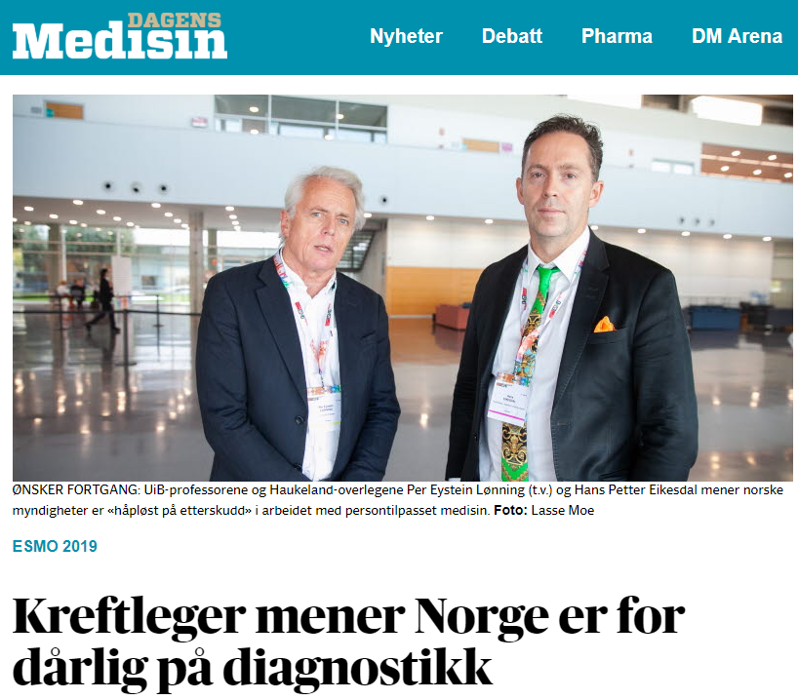
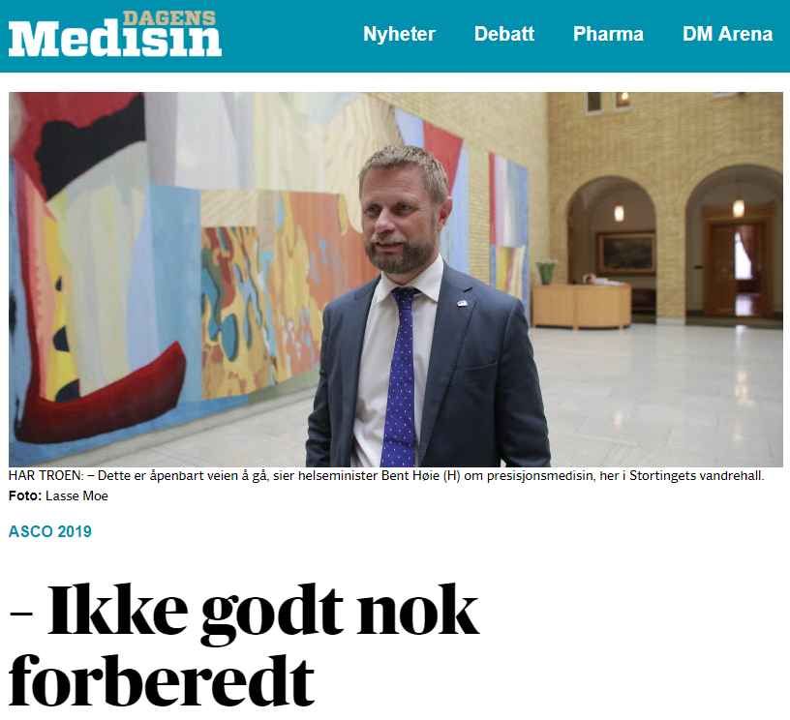
Background – national challenges
National strategy for implementation of precision medicine
Both political leaders and clinicians are impatient
Infrastructure is needed
There is a need for national guidelines on how the hospitals should implement precision medicine
Should we implement large gene panels for all?
If not, how should patients be stratified?

Slide 4
Background – local challenges
There is an increasing focus on precision medicine and its use in treatment stratification
We expect an increasing number of requests for diagnostic tests that can predict response to treatment.
Haukeland University Hospital do not provide all the gentic tests that are required in the current national guidelines
Cancer genomics for diagnostic use is currently done in several of our departments (Pathology, Medical genetics and Medical biochemistry)
Samples are largely from our own hospital, but also from the rest of Helse Vest as well as other regions of Norway

Slide 5
Cancer genomics in diagnostics
Requirements for routine laboratories are quite different than in research
All our laboratories are accredited and run analyses according to stringent protocols
Run to run-variation must be low
Everything must be thouroughly documented
Quality control is a big part of the daily tasks
Interpretation of sequence variants will be a major task, and finding people with the necessary competence will be a major challenge

Slide 6
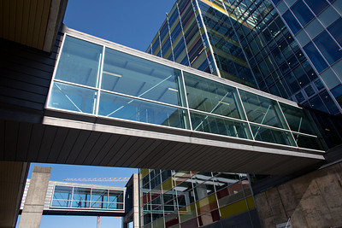
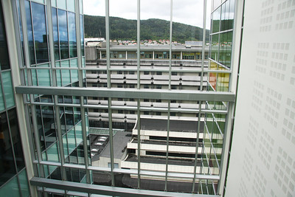
The cancer genomics project at Haukeland University Hospital
Local project in Laboratorieklinikken
Reference group with clinicians from the hospital

Slide 7
The cancer genomics project at Haukeland University Hospital
Cancer genomics will be organized as a separate unit
We want to organize our activity in way that allows our diagnostic pipeline to handle increasing volumes, from both blood (e.g. liquid biopsies) and solid tumors
The goal is a better service to our clinicians, and improved treatment of our patients

Slide 8
The cancer genomics project at Haukeland University Hospital
To a large extent this is a logistics and organizational project
Evaluate which type of competence we need
Technical, biomedical laboratory scientists, molecular biologists, pathologists, clinicians
How should we integrate this activity with other relevant activity (e.g. immune phenotyping of leukemia)
We will also assess how this new unit should handle clinical trials and explorative diagnostics for our hospital.

Slide 9
How to organize
Nivå 3 - Seksjon
Cancer genomics unit
Unit leader
Cancer genomics R&D
Team leader
Cancer genomics blood
Cancer genomics solid
Team leader blood
Team leader solid
Dept. of Medical genetics
-leukemia
Dept. of Clinical biochemistry
Molecular analysis
-hematological
malignancies
Dept. of Pathology
-molecular pathology

Slide 10
Step-wise implementation
In step one:
Merging cancer tests for leukemia/hematological malignancies
Implement a myeloid gene panel
Implement a focus gene panel (52 genes) for solid tumors
In step two:
Merge methods of molecular pathology into this pipeline
Expand to larger gene panels (500 genes)
End goal
Have a dedicated cancer genomics laboratory doing «everything» except specialized tests (like G-banding and histological studies)

Slide 11
What does this require?
Adaptation and development of our laboratory information system – big job!
Bioinformatic support
More space
Extraction of activity from three seperate departments to one new units
Concequenses for employees
More people
Several recruitments are ongoing

Slide 12
Challenges
We do not know when the expected large volume for solid tumors will «hit»
Planning our activity in a rapidly changing field
Gene panels?
Exome sequencing?
Whole genomes?
Liquid biopsies?
Detection of germ-line mutations
How should we handle clinical studies?

Slide 13
Precision medicine is teamwork!
Teamworkers from all other health professions
Clinical geneticists
Administrative support
Genetic counsellors
Bio/informaticians
Laboratory geneticists
Technicians

Slide 14
Establishing precision medicine in the health care service is no quick fix
– but the potential for benefit if done right is enormous!

