Slide 1
Precision medicine in Northern Norway
Rune Sundset, Head of PET Imaging Center, University Hospital North Norway

Slide 2
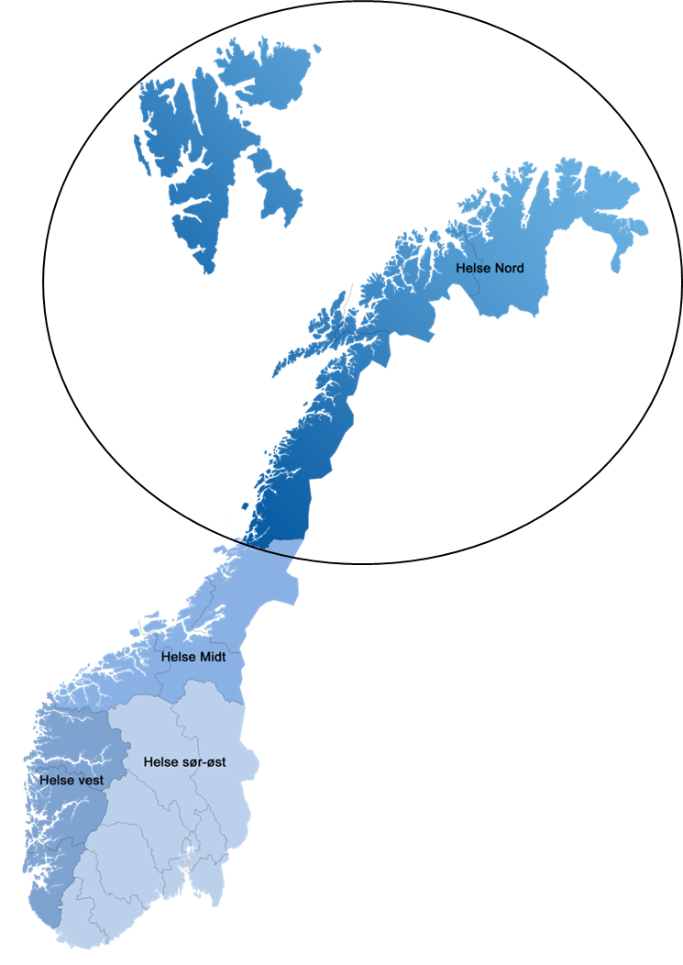
University Hospital North Norway
Tromsø
University and regional hospital for Nordland, Troms, Finnmark and Svalbard (486,000 people)
Local hospital for Troms and northern Nordland (187,000 people)

Slide 3

Tromsø
Hospital and university
Airport
Downtown

Slide 4
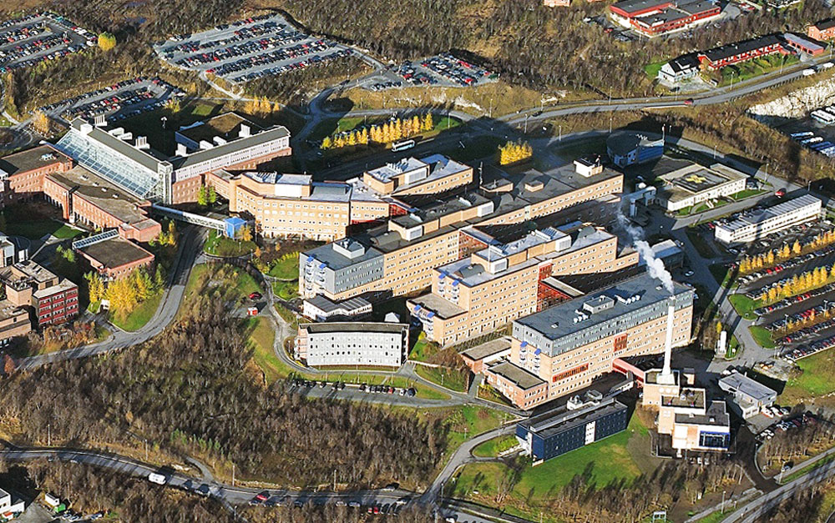
Universty of Tromsø - The Arctic University of Norway
Medical faculty
PET Imaging Center
University Hospital of North Norway

Slide 5
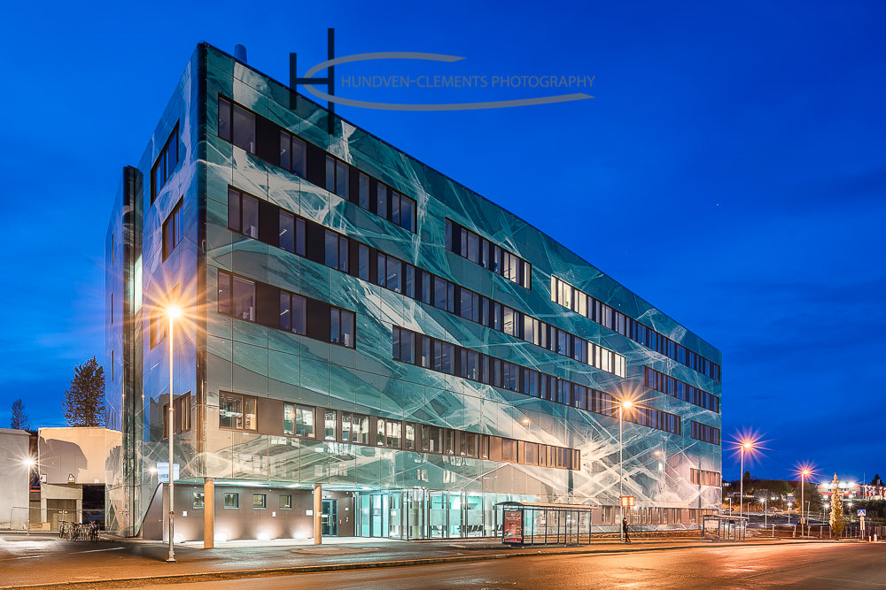

Slide 6


2013/2014
2015/2016
National strategies
in precision medicine

Slide 7
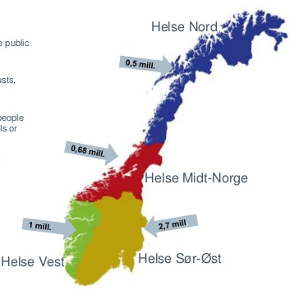
2017 – National working group:
Based on the previous strategies
Establish national and regional network in each health region for precision medicine (PM)
  Avoid unwanted differences between health regions
  Education and information
  Secure a national plan in PM
National report on how to make a national network in PM.
Nasjonalt nettverk av regionale fagråd innen persontilpasset medisin
Rapport fra nasjonal arbeidsgruppe nedsatt etter oppdrag fra Helse- og omsorgsdepartementet, 2017-18 (revidert etter konklusjon i AD-møte 19.11.2018)
«Personalized medicine includes diagnostics, treatment and prevention of disease based on a detailed biological information on the individual or on the individual’s disease»

Slide 8
National organization
Directors (fagdirektør) Regional Health Authorities (4)
National council for precision medicine (PM)
Leaders of regional councils (4)
Ministry of e-Health (1)
Ministry of Health (1)
User representatives (2)
Secretary (1)
Regional council PM Helse Vest
Regional council PM Helse Sør-Øst
Regional council PM Helse Midt-Norge
Regional council PM Helse Nord

Slide 9
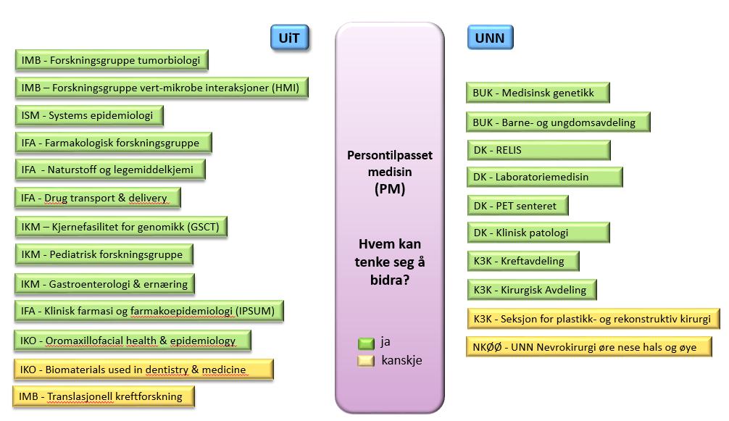
Regional council PM in Northern Norway
Research groups at UiT – The arctic university of Norway
(UiT)
Clinical departments at the University Hospital North Norway
(UNN)
Regional working group 2018/19:
UiT – The arctic university of Norway (UiT)
University Hospital North Norway (UNN)
survey and workshops
proposed organization

Slide 10



Director UNN (Hospital) / Dean Medical Health Faculty - UiT (University)
Proposed regional organization of PM in Northern Norway
Regional council for precision medicine
Leader
One member from each discipline:
Genetic
Oncology
Infection diseases
Pathology
Bioinformatics
Molecular imaging and therapy (nuclear medicine)
…
Regional professional network in precision medicine
All employees working in the field of:
Genetic
Oncology
Infection diseases
Pathology
Bioinformatics
Molecular imaging and therapy (nuclear medicine)
…
Annual conference

Slide 11
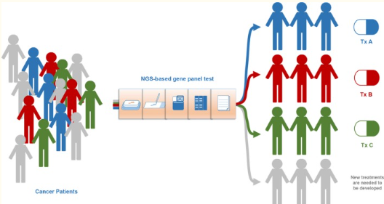
Gene panels for cancer at UNN in Tromsø
Small panel (15 genes)
  Lung cancer, colon-/rectal cancer, melanoma
  Mutations (EGFR, RAS,BRAF etc)
  Introduced March 2017
Larger panel (200 genes)
  Child cancer (many different types)
  Mutations and gene fusions
  Introduced October 2019
Large panel (500+ genes)
  Part of a clinical study
Nagahashi M at al. Cancer Sci. 2019;110:6–15.
Notes:
In cancer genomics, biomarkers in the tumor is investigated and now also genetic markers (biomarkers
Used to test one biomarker at the time, but as in medical genetics, technology has provided the possibility to test many markers at the same time.
Molecular pathology characterizes the genetic changes in a tumor in high resolution
Personlized medicine is now routine diagnostic for lung patients and is part of a national strategy that UNN also is a partner in

Slide 12
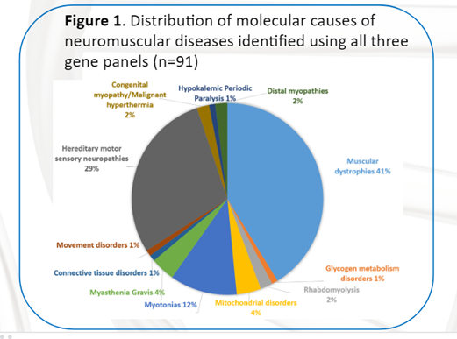
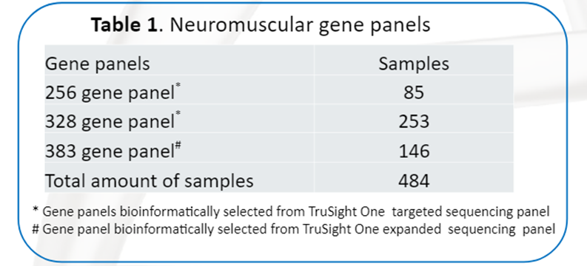
Next generation sequencing - new molecular diagnostic possibilities in neuromuscular patients
We screen up to 383 genes associated with neuromuscular diseases in a large gene panel that has been developed at UNN
Panel has expanded over three years, diagnosis in approxinately 20% of patients
Treatments/drugs available or under progress for some diagnosis
Notes:
New diagnostic possibilities in diseases where many genes are involved and test for only a few genes were possible to provide earlier. Now we screen up to 383 genes associated with neuromuscular diseases in a large gene panel that we have developed at UNN. High rate of diagnosis. Some of these have been in the system for decades

Slide 13
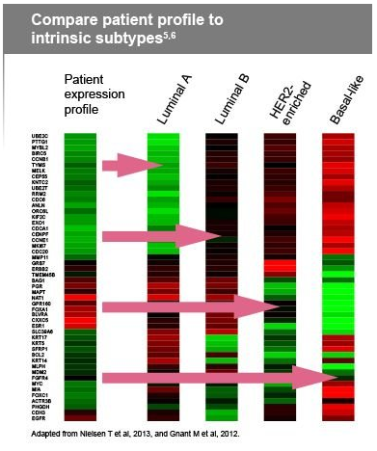
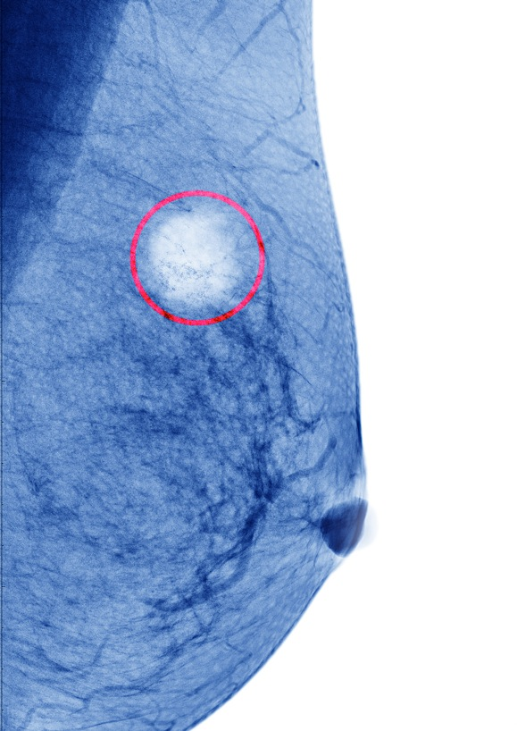
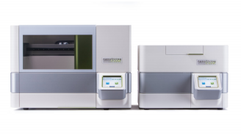
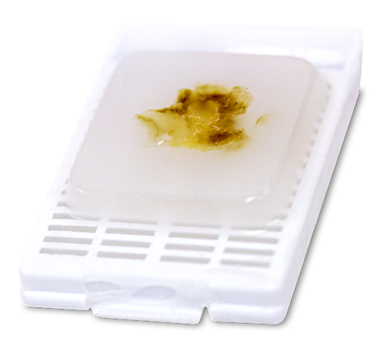
Prosigna test for breast cancer (EMIT study, lead by OUS)
UNN: first patient in april 2019
Biopsy
Prosigna test (NanoString):
Molecular classification based on gene expression in tumour
Calculates risk of relaps
Benefit for the patients
Low risk of relaps – no need for chemotherapy
Avoid chemotheraphy in patients with no effect (avoid side effects)
Notes:
I første omgang innføres testen som en del av en nasjonal klinisk studie: EMIT-1 studien. Drevet i fra Oslo. , involverer alle regionene i Norge. Første pasient ble testet ved UNN i april. Innført gjennom beslutningsforum
I behandling av brystkreft får pasienter ofte adjuvant cellegift for «sikkerhet skyld». Men mange pasienter vil ikke få tilbakefall uansett. For slike pasienter er medfører derfor cellegift en unødvendig belastning.
Testen gir grunnlag for å identifisere de pasientene som har meget lav risiko for tilbakefall, og derfor ikke har nytte av cellegift.
Ved å teste brystkreftpasienter vil en stor andel pasienter nå kunne slippe å gjennomgå adjuvant cellegiftbehandling. Dette sparer pasienten for en unødvendig og tøff behandling, og gir samfunnet reduserte kostnader til helsetester og sosiale utgifter.
Clinical study- introducing new diagnostics.
Kombinert innføring er bra- måler effekten samtidig
Føste utenom OUS som etablerte dette. R
Her ser vi resultatet av å være med i en klinsik studie som blir rutinediagnostikk i løpet av kort tid

Slide 14
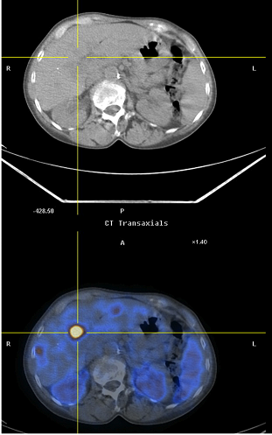
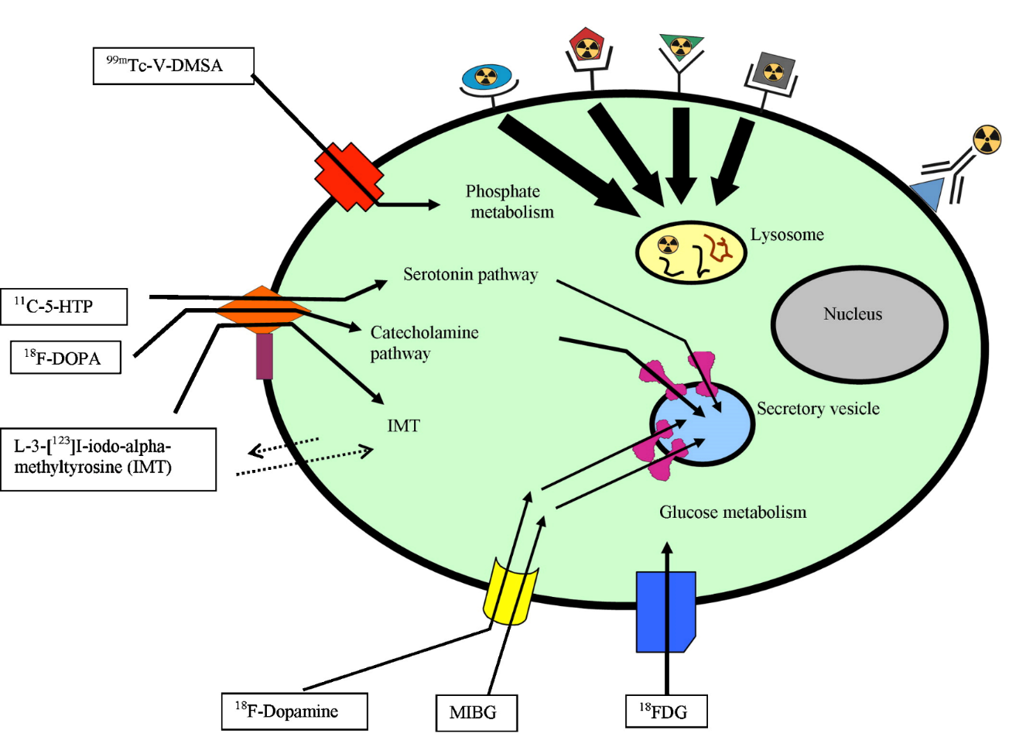
Peptide Receptor Radionuclide Therapy (PRRT, radioisotope therapy)
Somatostatinreceptor
(Nevroendocrine tumores)
^{99m}Tc – somatostatin-analog
¹⁷⁷Lu - somatostatin-analog

Slide 15
Nuclear medicine - THERANOSTICS
Precision medicine
Precision-DIAGNOSTICS
Precision-THERAPY

Slide 16


